Slide 1
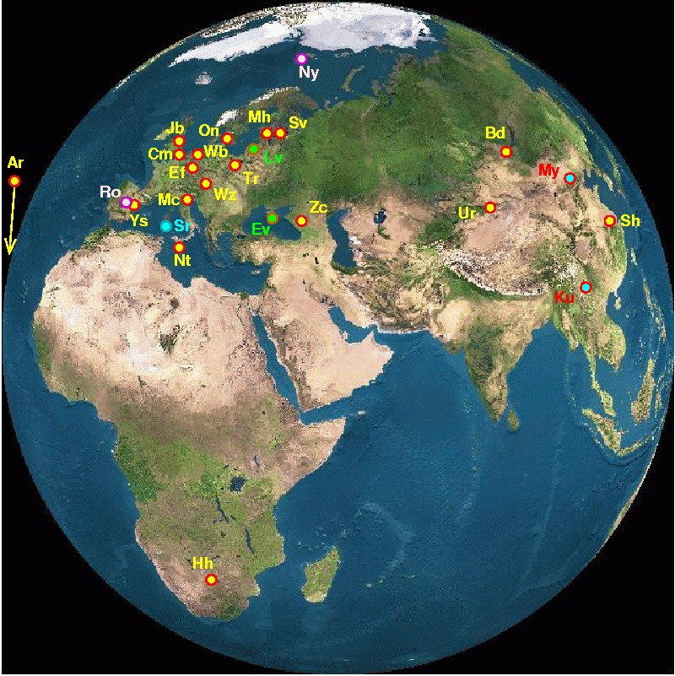
EVN Users Meeting Tom Muxlow Cagliari, 9th October 2014
,
Notes:
Two main results since last review
H1 absorption studies
First VLBI study

Slide 2
Agenda for EVN Users Meeting
9th October 2014 15:30 – 17:00
1) Introduction – Tom Muxlow
a. EVN PC Update
b. Recent additions to EVN capabilities
c. Proposal statistics
2) Correlator and Proposal Tool Updates – Bob Campbell
3) EVN Scheduling – Alastair Gunn
4) Open Discussion – Miguel Perez-Torres (Motivator)
a. Recent proposal numbers (suggested by Tom Muxlow)
b. Calibration Issues (ANTAB tables) (suggested by Robert Schulz)
c. Global VLBI at ~150MHz (suggested by Olaf Wucknitz)
d. mm-band improvements (suggested by Richard Dodson/Maria Roija)
5) AOB Tom Muxlow, 09-10-2014

Slide 3
EVN PC Membership
Members from EVN Institutes
A. Bartkiewicz (Torun) B. Campbell (JIVE) M. Giroletti (INAF-IRA)
Z. Shen (Sh + Ur) M. Lindqvist (OSO) * A. Lobanov (MPIfR) – Secretary
A. Polatidis (ASTRON) A. Melnikov (St Petersburg) T. Muxlow (JBCA/e-MERLIN)*-Chairperson
“At Large” Members
Angela Bazzano (INAF IAPS Rome) M. Pérez-Torres (IAA-CSIC)
S. Frey (FOMI) E. Humphreys (ESO)
Representatives
A. Gunn EVN Scheduler
B. Campbell EVN Correlator at JIVE
NRAO Representatives
M. Claussen NRAO Scheduler
Also Ken Kellermann & Toney Minter
Recent Appointments
Chairperson rotates om January 1st 2015
*Michael Lindqvist replaces Tom Muxlow

Slide 4
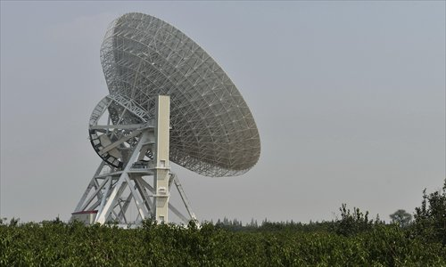
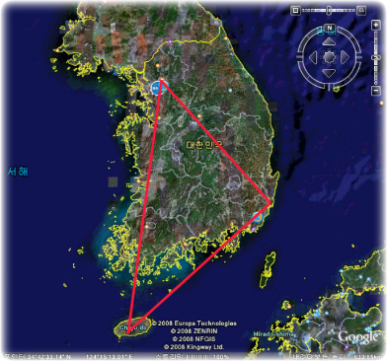
Recent Additions to EVN Facilities The new 65m Tianma (Shanghai) telescope will become available for EVN operations from Session 1 2015. Default is still Sheshan (25m) so additional scientific justification is required See the EVN Status Table for details.
The Korean VLBI Network (KVN) has now become an Associate Member of the EVN (as from January 2014). 3 21m antennas available: Yonsai, Ulsan, Tamna KVN telescopes may be requested for EVN observations at 1.3cm and 7mm wavelengths. For more details regarding the KVN, see: http://kvnweb.kasi.re.kr/en/en_normal_info.php

Slide 5
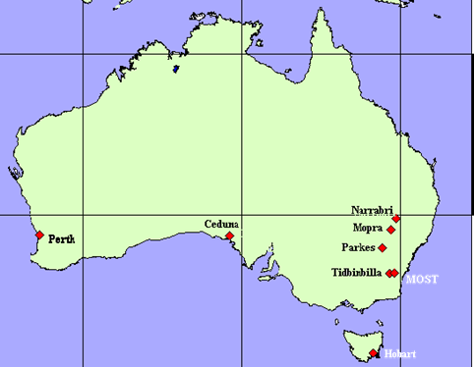
Use of Australian VLBI Network Antennas (LBA) Starting in Session 1 2015, some Australian Long Baseline Array (LBA) time has been made available for simultaneous scheduling with the EVN, thus enabling the possibility of joint LBA/EVN observations in that and future disc sessions. Proposals for joint LBA/EVN observations in session 2/2015 must be submitted separately to both the LBA and EVN: LBA in their 15 Dec 2014 deadline. EVN in their 1 Feb 2015 deadline. For details regarding proposing on the LBA, see: http://www.atnf.csiro.au/observers/apply/avail.html http://www.atnf.csiro.au/vlbi/index.html EVN+LBA observations should be possible at all principal EVN wavebands from 21 cm to 1.3 cm.: See: http://www.evlbi.org/user_guide/freq_cov.html No take-up as yet for these LBA facilities…

Slide 6
Out of Session Observing Out-of-Session observing time (up to a maximum of 144 hours/year), is now available to all proposals. Proposals requesting Out-of- Session observing time must provide full scientific (and technical if appropriate) justification as to why observations must be made outside regular sessions. Proposals will only be considered for dates occurring after the regular EVN session that follows the proposal deadline. Observations requiring much shorter lead times should be submitted as "Target-of-Opportunity" proposals. For this and all developments shown here – see the recent call for proposals: http://www.evlbi.org/proposals/call.txt

Slide 7
Coming soon to a telescope near you…
A commensal survey of fast transients with the EVN
EVN Proposal EP089 (LOCATe consortium) – agreed by the CBD
Piggyback survey to run in the background on your proposal.
Discussions continuing to put required infrastructure in place.
PI will be able to opt out it they want to. Your programme data are still proprietary!!
You will be fully consulted……
Automated trigger programmes
Rapid response on timescale of minutes – new transient science (from user pressure)
Carefully defined generic proposals allowed
Rigorous trigger criteria required
Limited programme lifetime
Programmes will be graded by PC and will sit in a queue awaiting e-VLBI sessions
Approved programmes can displace scheduled programmes of lower grade in e-VLBI.
Trigger displacement tests are continuing – Once reliable, details to be announced…

Slide 8
Detailed Proposal Trends
Breakdown of submitted proposal band requests over the past four years.
Dominated by L- and C-Band proposals - but significant demand for other bands
Less recent demand for 5cm
+ Occasional 90cm
Low frequencies?

Slide 9
Detailed Proposal Trends
Breakdown of submitted proposal science areas over the past four years.
Still dominated by classical areas of AGN/jets, stellar evolution
Starburst/ULIRGs and masers still strong but demand has dipped a little
More specialized astrometry and spacecraft tracking programmes continue

Slide 10
Proposal trends over 9 years
2014 final figures assume an average of 11 ToOs/year

